Slide 1
Chapter 8 Advanced Counting Techniques
8.1 Applications of Recurrence Relations
8.2 Solving Linear Recurrence Relations
8.3 Divide-and-Conquer Algorithms and
Recurrence Relations
8.4 Generating Functions
8.5 Inclusion-Exclusion
8.6 Applications of Inclusion-Exclusion

Slide 2
Chapter 8 Advanced Counting Techniques
Several Advanced Counting Techniques:
  Recurrence Relations
  Generating Functions
  The Principle of Inclusion-Exclusion

Slide 3
8.1 Applications of Recurrence Relations
1. Introduction
Problem:
The number of bacteria in a colony doubles every hour. If a colony begins with five bacteria, how many will be present in n hours?
A variety of counting problems can be modeled using recurrence relations.

Slide 4
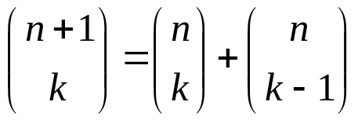
8.1 Applications of Recurrence Relations
2. Recurrence Relations
【Definition】 A recurrence relation for the sequence {a_{n}} is an equation that expresses a_{n} in terms of one or more of the previous terms of the sequence, namely, a₀ , a₁ , a₂ , … , a_{n-1} , for all integers n with n≥n₀,where n₀ is a nonnegative integers.
a_{n} = f ( a₀ , a₁ , a₂ , … , a_{n-1} ) n≥n₀
For example,
The Fibonacci sequence a_{n} = a_{n-1} + a_{n-2} .
Pascal's recursion for the binomial coefficient is a two-variable recurrence equation:

Slide 5
8.1 Applications of Recurrence Relations
A solution of a recurrence relation is a sequence if its terms satisfy the recurrence relation.
〖Example 1〗 Determine whether the sequence {a_{n}} is a solution of the recurrence relation a_{n} = 2a_{n-1} - a_{n-2} for n = 2,3,4,…,where a_{n} = 3n for every nonnegative integer n.
Answer the same question where a_{n} = 2^{n} and where a_{n} = 5 .
Solution :
a_{n} = 3n
a_{n} = 2^{n}
a_{n} = 5




Slide 6
8.1 Applications of Recurrence Relations
Note:
Normally, there are infinitely many sequences which satisfy a recurrence relation.
We distinguish them by the initial conditions, the values of a₀ , a₁ , a₂ , ... to uniquely identify a sequence.
Given a recurrence relation, how many initial conditions are needed to uniquely identify the sequence?
The degree of a recurrence relation
a_{n} = a_{n-1} + a_{n-8} ---- a recurrence relation of degree 8

Slide 7
8.1 Applications of Recurrence Relations
For example,
In the Fibonacci recurrence a_{n} = a_{n-1} + a_{n-2} we must specify a₀ and a₁ .
In Pascal's identity
we must specify C(1,0) and C(1,1).

Slide 8
8.1 Applications of Recurrence Relations
3. Modeling with Recurrence Relations
〖Example 2〗 Rabbits and the Fibonacci numbers
A young pair of rabbits is placed on an island. A pair of rabbits does not breed until they are 2 months old. After they are 2 months old, each pair of rabbits produces another pair each month. Find a recurrence relation for the number of pairs of rabbits on the island after n months, assuming that no rabbits ever die.

Slide 9
8.1 Applications of Recurrence Relations
Solution :
f_{n} : The number of pairs of rabbits after n month
f₁ = 1
f₂ = 1
f₃ = 1+1 = 2
f₄ = 2+1 = 3
……
f_{n} = f_{n-1} + f_{n-2}

Slide 10
8.1 Applications of Recurrence Relations
〖Example 3〗 The Tower of Hanoi
H_{n} = 2H_{n-1} + 1
= 2(2H_{n-2} + 1) + 1
= 2²H_{n-2} + 2 + 1
= 2²(2H_{n-3} + 1) + 2 + 1
= 2³H_{n-3} +2²+ 2 + 1
= …
= 2^{n-1}H₁+ 2^{n-2} +…+ 2 + 1
= 2^{n-1}+ 2^{n-2} +…+ 2 + 1
= 2^{n} - 1
Solution :
Let H_{n} denote the number of moves needed to solve The Tower of Hanoi problem with n disks
H₁ , H₂ , … , H_{n} , …
H_{n} = 2H_{n-1} + 1
H₁ = 1
How to solve this recurrence relation?
Method: Use an iterative approach

Slide 11
7.1 Recurrence Relations
〖Example 4〗Find a recurrence relation for the number of bit strings of length n that don’t have two consecutive 0s.
Solution :
Let a_{n} denote the number of bit strings of length n that don’t have two consecutive 0s.
Any bit string of length n-1 with no two consecutive 0s.
1
a_{n-1}
Any bit string of length n-2 with no two consecutive 0s.
1
0
a_{n-2}
Recurrence relation:
a_{n} = a_{n-1} + a_{n-2} , n>=3.
Initial conditions: a₁=2, a₂=3

Slide 12
7.1 Recurrence Relations
〖Example 5〗Codeword Enumeration: A computer system considers a string of decimal digits a valid codeword if it contains an even number of 0 digits. Let a_{n} be the number of valid n-digit codeword. Find a recurrence relation for a_{n}.
a_{n} =9 a_{n-1} +(10^{n-1}- a_{n-1})

Slide 13
Chapter 8 Advanced Counting Techniques
8.1 Applications of Recurrence Relations
8.2 Solving Linear Recurrence Relations
8.3 Divide-and-Conquer Algorithms and
Recurrence Relations
8.4 Generating Functions
8.5 Inclusion-Exclusion
8.6 Applications of Inclusion-Exclusion

Slide 14
8.2 Solving Linear Recurrence Relations
The Methods of Solving Recurrence Relations
  Iterative approach
  Use a systematic way to solve an important class of
  recurrence relations
  Generating functions
Solving recurrence relations can be very difficult unless the recurrence equation has a special form.

Slide 15

8.2 Solving Linear Recurrence Relations
Linear homogeneous recurrence relation of degree k with constant coefficients
where c₁, c₂,…, c_{k} are real numbers, and c_{k} ≠0
linear
- linear combination of previous terms
constant coefficients
the coefficients of a_{i}s are constants
degree k
a_{n} is a function of the previous k terms of the sequence
homogeneous
If we put all the a_{i} s on the left side of the equation and everything else on the right side, then the right side is 0. Otherwise nonhomogeneous.

Slide 16
8.2 Solving Linear Recurrence Relations
Linear homogeneous recurrence relation of degree k with constant coefficients
where c₁, c₂,…, c_{k} are real numbers, and c_{k} ≠0
A sequence satisfying the recurrence relation in the definition is uniquely determined by the recurrence relation and the k initial conditions
a0=C0, a1= C1, … , ak-1=Ck-1

Slide 17
8.2 Solving Linear Recurrence Relations
〖Example 1〗
(1) a_{n} = (1.02)a_{n−1}
linear; constant coefficients; homogeneous; degree 1
(2) a_{n} = (1.02) a_{n−1} + 2^{n−1}
linear; constant coefficients; nonhomogeneous; degree 1
(3) a_{n} = a_{n−1} + a_{n−2} + a_{n-3} + 2^{n−3}
linear; constant coefficients; nonhomogeneous; degree 3
(4) a_{n} = n a_{n−1} + n² a_{n−2} + a_{n−1} a_{n−2}
nonlinear; coefficients are not constants; homogeneous; degree 2

Slide 18
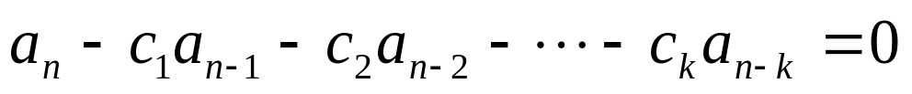
8.2 Solving Linear Recurrence Relations
1. Solving Linear Homogeneous Recurrence Relation With Constant Coefficients
The basic approach:
To look for solutions of the form a_{n} = r^{n} , where r is a constant.
Solution Procedure:
(1) Put all a_{i}s on the left side of the equation
(2) Substitute the solution into the equation, factor out the lowest power of r and eliminate it.

Slide 19
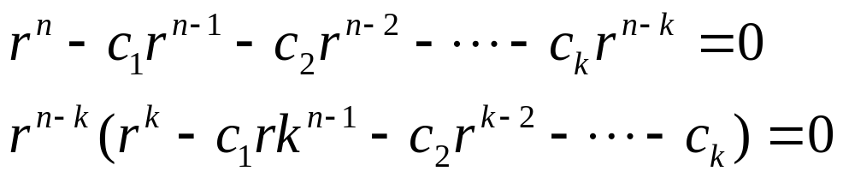

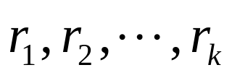
8.2 Solving Linear Recurrence Relations
Characteristic equation
(3) We obtain the equivalent equation
Characteristic root
(4) Find its k roots
These characteristic roots can be used to give an explicit formula for all the solutions of the recurrence relation.

Slide 20





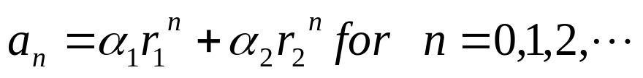

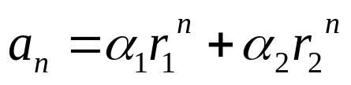
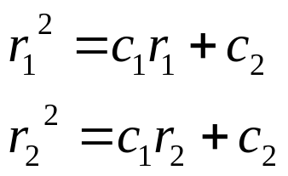
8.2 Solving Linear Recurrence Relations
【 Theorem 1】 Let be real numbers. Suppose that
has two distinct roots . Then the
Sequence is a solution of the recurrence relation
if and only if
, where are constants.
Proof:
Show that if are the roots of the characteristic equation, and are constant, then the sequence
is a solution of the recurrence relation

Slide 21

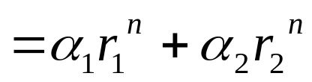
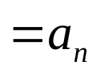
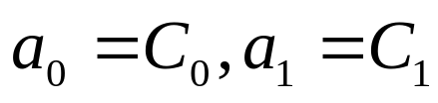
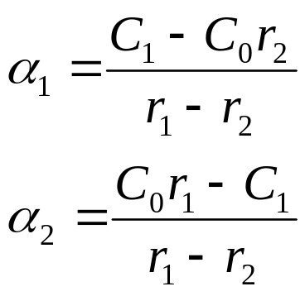
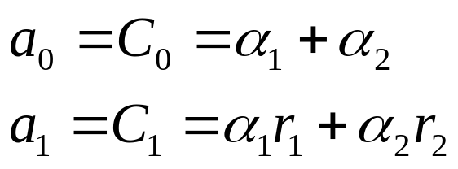
8.2 Solving Linear Recurrence Relations
Show that if is a solution, then for some constant .
Suppose that is a solution, and the initial condition
hold.

Slide 22

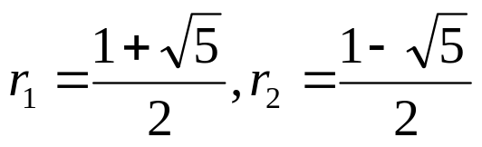
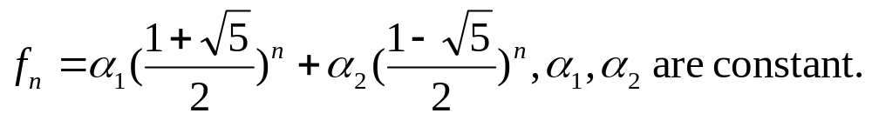
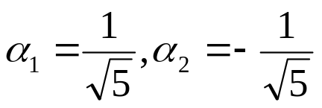
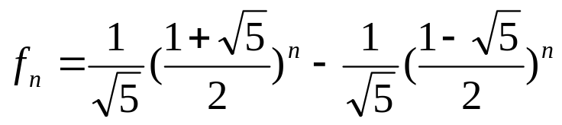
8.2 Solving Linear Recurrence Relations
〖Example 2〗Find an explicit formula for the fibonacci numbers.
Solution:
f_{n} = f_{n-1} + f_{n-2} , f₀ = 0, f₁ = 1
(1) Determine the characteristic equation:
(2) Find its roots:
(3) Obtain the general solution:
(4) Dtermine :
Consequently, the fibonacci numbers are given by

Slide 23

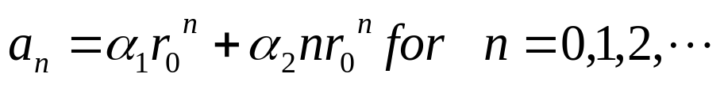

8.2 Solving Linear Recurrence Relations
【 Theorem 2】 Let be real numbers with c₂≠ 0.
Suppose that has only one root .
A sequence is a solution of the recurrence relation
if and only if
, where are constants.
Proof:
Omitted.

Slide 24




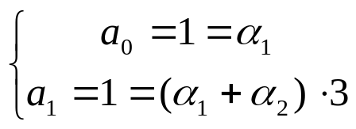
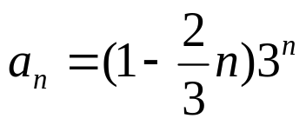
8.2 Solving Linear Recurrence Relations
〖Example 3〗
Solution:
(1) Determine the characteristic equation:
(2) Find its roots :
(3) Compute the general solution:
(4) Solve for coefficients :
Consequently,

Slide 25



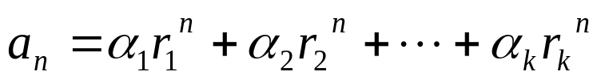



8.2 Solving Linear Recurrence Relations
【 Theorem 3】 Let be real numbers. Suppose that
the characteristic equation has k
distinct roots . Then a sequence is a solution of
the recurrence relation
if and only if
for where are constants.
The coefficients are found by enforcing the initial conditions

Slide 26
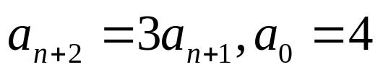



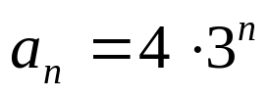
8.2 Solving Linear Recurrence Relations
〖Example 4〗 What is the solution of the recurrence relation
Solution:
The Characteristic equation of the recurrence relation is r – 3=0 .
(2) Find the root of the characteristic equation:
(3) Compute the general solution:
(4) Find the constants based on the initial conditions:
(5) Produce the specific solution:

Slide 27




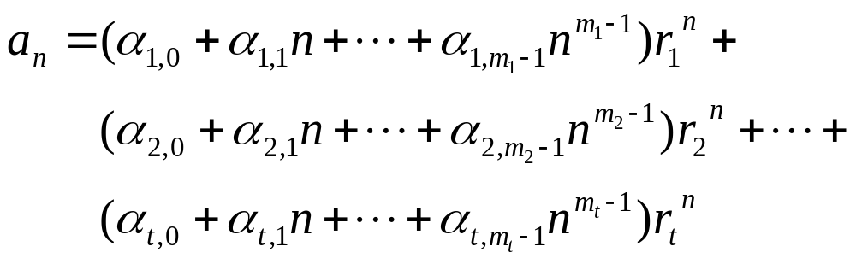

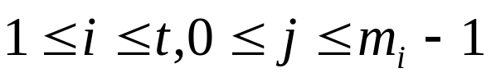
8.2 Solving Linear Recurrence Relations
【 Theorem 4】 Let be real numbers. Suppose that
the characteristic equation has t
distinct roots with multiplicities ,
respectively, so that and
Then a sequence is a solution of the recurrence relation
if and only if
for where are constants for
.

Slide 28
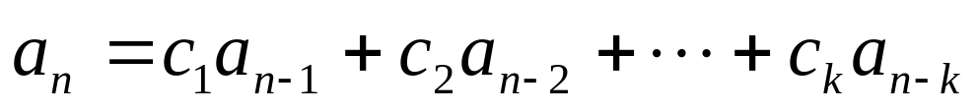
8.2 Solving Linear Recurrence Relations
2. Linear Nonhomogeneous Recurrence Relation With Constant Coefficients
Where c_{i}(i=1,2,…,k) is real numbers, F(n) is a function not identically zero depending only on n.
the associated homogeneous recurrence relation
Note:
  Solutions to nonhomogeneous case is the sum of solutions to associated homogeneous recurrence system and a particular solution to the nonhomogeneous case.

Slide 29




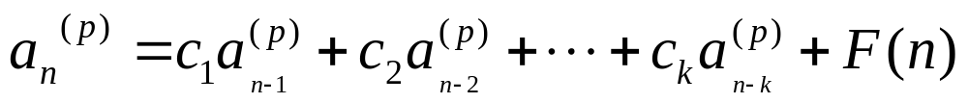
8.2 Solving Linear Recurrence Relations
【 Theorem 5】 Let be a particular solution of the
nonhomogeneous linear recurrence relation with constant
coefficients
Then every solution is of the form , where
is a solution of the associated homogeneous recurrence relation.
Proof:
Suppose that {b_{n}} is a second solution of the nonhomogeneous recurrence relation, so that

Slide 30
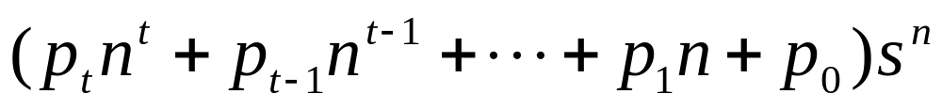
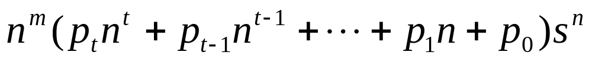
8.2 Solving Linear Recurrence Relations
【 Theorem 6】 Assume a linear nonhomogeneous recurrence
equation with constant coefficients with the nonlinear part
F(n) of the form
If s is not a root of the characteristic equation of the associated homogeneous recurrence equation, there is a particular solution of the form
If s is a root of multiplicity m , a particular solutions is of the form

Slide 31
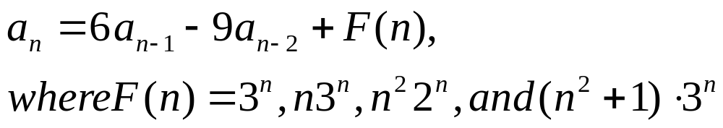
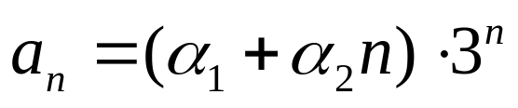
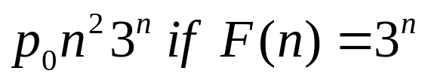
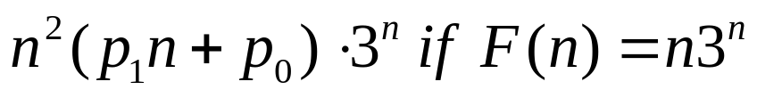
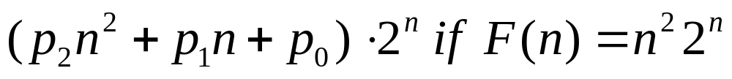
8.2 Solving Linear Recurrence Relations
〖Example 5〗
Solution:
(1) The general solution of the associated homogeneous recurrence equation :
(2) A particular solution of the form:

Slide 32
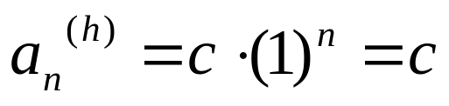
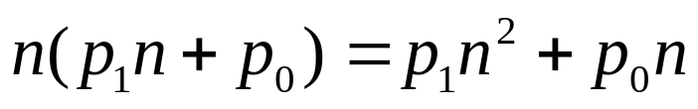
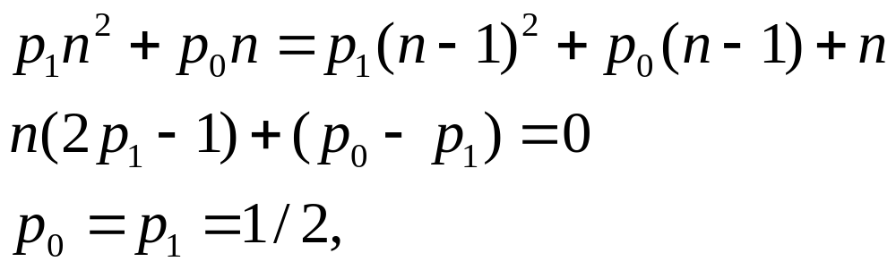
8.2 Solving Linear Recurrence Relations
〖Example 6〗Let a_{n} be the sum of the first n positive integers. Note that a_{n} satisfies the recurrence relation a_{n}= a_{n-1}+n. Find The explicit formula of a_{n}
Solution:
(1) The general solution of the associated homogeneous recurrence equation :
(2) A particular solution of the form:
(3) Find p₁,p₀:
(4) Find c: using initial condition a₁=1

Slide 33
Homework: (No need to submit)
Ver. 8 & Ver. 7
Sec. 8.1: 8, 10, 26, 29, 32
Sec. 8.2 2, 4(g), 20, 30, 35

